Slide 1

Parent Engagement Conversation Starters

Slide 2
Conversation Starters
Tips for getting started:
Parents and caregivers can play an important role in the lives of young people by: teaching the importance of having honest, respectful and equitable romantic relationships and by supporting adolescents to make responsible decisions that support their own safety, health and wellness. Our children are always looking to us for how to be so don’t underestimate how much we’ve already taught them by modeling behaviors in our own relationships.
Wondering where to start? Here are some suggestions for beginning the conversation with your teen(s) and tween(s.)
Not comfortable with the topic or feel you don’t know enough about the issue? Check out our resources to learn more about healthy relationships and dating abuse.
If you aren’t comfortable using the proposed language consider adapting these prompts to reflect how you already talk with your child(ren.)

Slide 3
Conversation Starters
Tips for getting started:
  Don’t just jump in to the “heavy” stuff. If you’re not used to these kinds of talks start off light. Come from a place of genuine curiosity. “What’s School like these days?” “Has COVID changed the way you get to interact with your friends?” “What subject in school are you liking the best?”
  How do you choose a friend? (boyfriend/girlfriend?)
  How do you know you can trust someone?
  Do you think people in relationships should be equal?
  What is the meanest thing someone could do to you?

Slide 4
Conversation Starters
Tips for getting started:
  Stay calm and be a good listener. You asked the question. If you react too strongly your child may not confide in you again.
  Answer questions honestly and let them know they can trust you. Relate what you are talking about to real life experiences, current events or movies. (Watch movies or tv or listen to music and use that as a “jumping off” point.)
  Have conversations while walking, driving or cooking together- it might seem more natural and make them feel less “on the spot.”

Slide 5
Conversation Starters
Healthy Relationships
  What do you think makes a relationship healthy?
  What makes a relationship good or bad?
  What do you think healthy relationships look like, feel like, and sound like?
  Can you point to a relationship you know of that you consider “healthy?”
  How do you know when you’re being respected by your dating partner or the person who is flirting with you?
  How do you know when you’re being respectful to your dating partner or the person with whom you’re flirting?

Slide 6
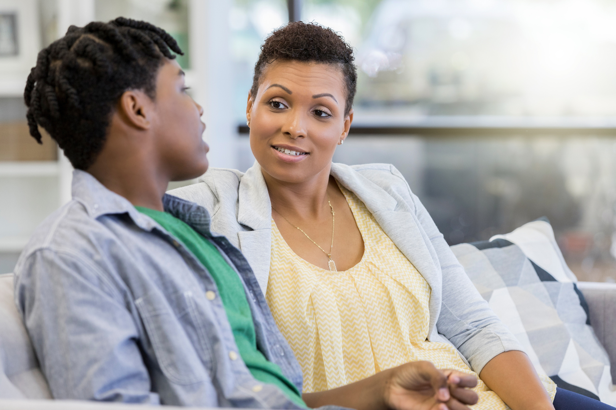
Actions and Talking Points
Healthy Relationships
  Healthy relationships have respect, safety, support, fairness and equality, acceptance, honesty, trust and open communication. Have some examples of each of these to expand on. For example, you might talk about having the ability to compromise and what that looks like.
  Healthy relationships are fun to be in.
  You can be yourself in a healthy relationship.
  Encourage emotional awareness. Teach your child how to express their feelings appropriately. Remind them that all feelings are valid. It’s how we act on those feelings that’s important.

Slide 7
Conversation Starters
Dating
  What are you and your friends calling dating these days?
  What does dating look like these days?
  Do different terms for dating mean different things? Do they mean different levels of commitment?

Slide 8
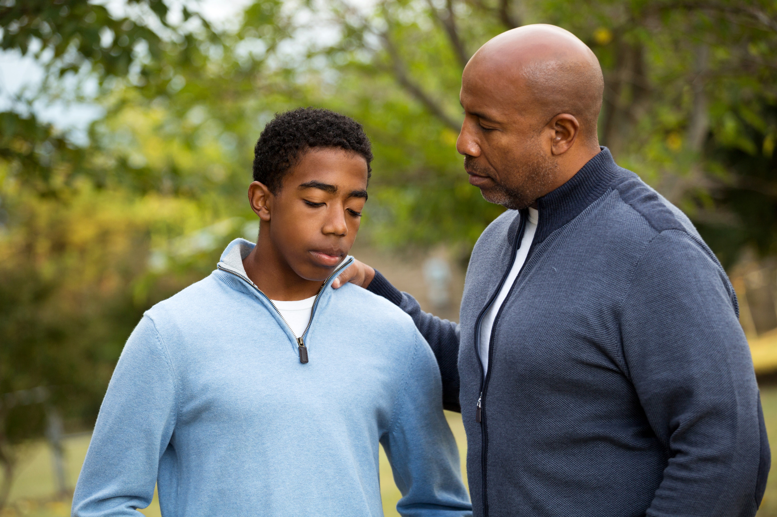
Actions and Talking Points:
Dating
  Explore different gender expectations we have of males and females by asking:
    "Are there certain things that boys want that girls don’t?" And vice versa.
  Discuss what respecting difference looks like using gender expansive language and references to sexual orientation, without judgement. Take their lead. Normalize different gender identities and sexual orientations. Get comfortable using language like “gay,” “lesbian,” “bi,” and “trans.”

Slide 9
Conversation Starters
Dating
  Have any of your friends been in what you think is a bad relationship?
  Have you ever worried about your friends or felt like they were being treated badly by someone they were dating?
  What excites you about starting to date (generally) and starting to date this person?
  Is there anything that makes you a nervous about starting to date? (or dating this person?)
  What are your expectations? What about the expectations of the person your dating? Have you talked about that yet?

Slide 10
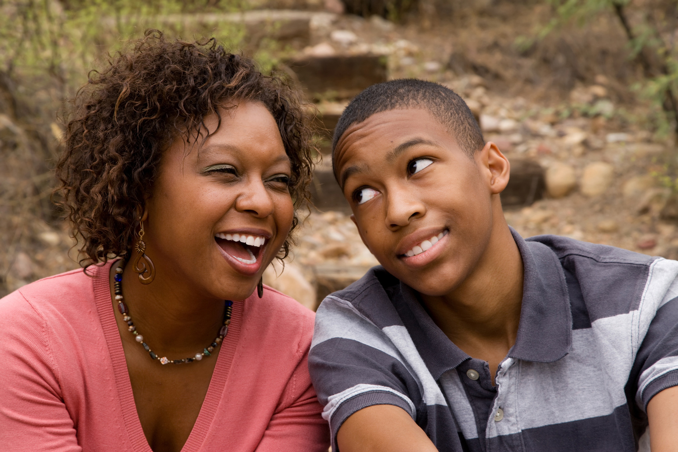
Actions and Talking Points:
Dating
  Your preteen or teen's definition of “unhealthy” or "abusive behaviors" or "violence" might be vastly different than your own.
  Talk to them about the difference between healthy and unhealthy relationship behaviors. Trust your instincts. Don't be afraid to talk to your child if you see warning signs of harassing or controlling behavior or if you suspect emerging abuse.
If you suspect that your child is being abused you can contact your local domestic violence program for some guidance on how to handle it.

Slide 11
Conversation Starters
Personal Boundaries
  It’s so important to have strong personal boundaries and be able to tell people what they are. Boundaries can be physical but they can also be emotional.
  What are some examples of someone saying or doing something that crosses your personal boundaries?
  Everyone has a right to express their feelings/needs/ expectations. What can you say to communicate how you want to be treated by others? What can you say and do to communicate your personal boundaries?
  How do you know when playing or teasing crosses the line and is no longer fun?

Slide 12

Actions and Talking Points:
Personal Boundaries
  Knowing what your personal boundaries are can help define your expectations about how you want to be treated.
  Communicating personal boundaries includes telling others what your expectations are and expressing when your boundaries have been crossed.
  Everyone has a right to communicate how they want to be treated by others. How can you do that in a respectful, non-threatening and comfortable way and on your own terms?
  Everyone has different personal boundaries and it’s important to treat a person the way they want to be treated as you want your boundaries respected, too.

Slide 13
Conversation Starters
Peer Pressure
  What are some of the things that you do when you hang out with your friends? “Hey! What are you and your friends up to these days?” “Are you doing anything fun?”
  Sounds like some of your friends are dating?
  How can you respond to pressure from a friend when they want you to do something you don’t feel comfortable with?
  How can you respond to pressure from someone you’re dating or seeing?

Slide 14

Actions and Talking Points:
Peer Pressure
  You have the power to choose the type of friendships and relationships you want.
  Even though a friend or dating partner may be comfortable with something or the choices they are making, it doesn’t mean you have to be.
  It’s important to be yourself. You don’t need to pretend to be something you aren’t or like something you don’t like because you think that’s what the other person wants. Real friends will like the real you.
  It is never okay to pressure, intimidate, control or threaten someone.
  Trust yourself to follow your gut and to make sure you feel respected, safe and comfortable.

Slide 15
Conversation Starter
Helping a Friend
What can you do if you hear a friend being disrespectful towards another friend or someone they are dating?

Slide 16
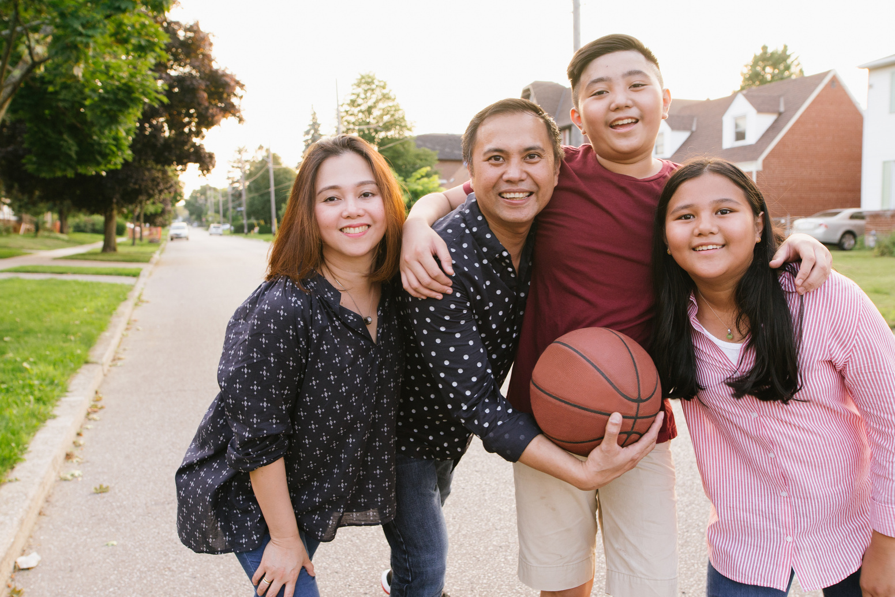
Actions and Talking Points:
Helping a Friend
  Help to create a “culture of respect” by being an ally and an “upstander.”
  Recognize and support your friends when you notice them being respectful towards one another and others.
  If you witness one of your friends being disrespectful, don’t join in on it. Instead, call your friend out and say “that’s not ok.”
  If you witness a situation that makes you feel unsafe, don’t intervene directly. Ask someone you trust, such as a coach, teacher, or school counselor, for help.
  If you think someone you know might be in an unhealthy or unsafe relationship, let them know there are people they can talk to and resources that can help, like a trusted adult or the Teen Dating Abuse Helpline. Helplines are anonymous and free.

Slide 17
Conversation Starters
Problem Solving
  How does it make you feel when you become aggressive during a game, a competition, or during an argument?
  When do you think aggression crosses the line?
  How can you control your anger and aggression during a disagreement to communicate respectfully?

Slide 18

Actions and Talking Points:
Problem Solving
  There is an important difference between asserting an opinion and becoming overly aggressive and potentially threatening.
  How can I support you to use language and actions that do not cause or have the intent to cause harm or fear.
  When problems come up in relationships, it is NEVER okay to use violence or threats of harm to control someone in order to get the outcome you want.
  Everyone has different personal boundaries. It’s important to respect boundaries -- to treat a person in the way that person wants to be treated.

Slide 19

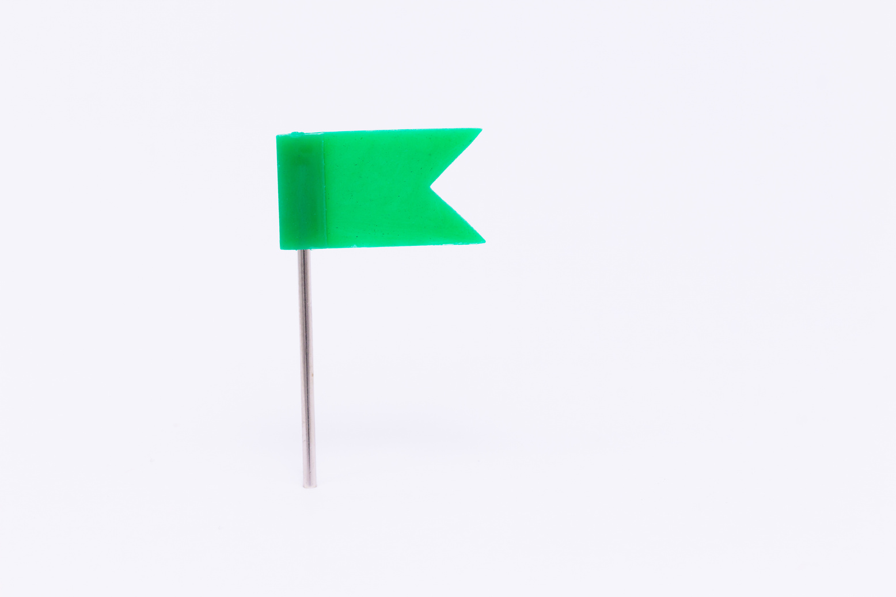

Red Flags vs. Green Flags
We often talk about red flags as signs indicating unhealthy or dangerous behaviors to watch out for. How often do we discuss what green flags are? Green flags (as in “go,”) are things we can identify as behaviors or viewpoints that are healthy, respectful and equitable. They are just as important to discuss, if not more, as the red flags as it gives us an opportunity to discuss a vision of a healthy relationship.
When discussing relationships, the focus is often on identifying signs of physical abuse. But there are many signs or red flags that are exertions of power and control and could be a precursor to physical abuse. These behaviors include: jealousy, possessiveness, insults, accusations, yelling, humiliation, pulling hair, pushing or other negative, physically threatening behaviors.

Slide 20
Do a Healthy Relationships Check-in
Using Green Flags:
Parents: You may approach these as prompts/questions you can use with your child(ren) or be aware of them as you observe relationships from a distance.
  Are they hanging out with their friends without their partner?
  Are they able to play sports or be a part of activities and hobbies they enjoy freely?
  Are they able to have privacy on their devices- do they share passwords to email, social media accounts or phone?
  Do they appear to be their authentic selves (fully themselves) when they are with their dating partner?
  Are they communicating well together? Is there a minimal amount of drama?
  Do they have shared values? Are they a good match?
  Do they demonstrate mutual respect for each other with their actions?

Slide 21
Promoting "Upstander" or "Ally" Behavior
To help your teen think about how they might stand up for what’s right think about the following examples:
A good friend of your child says that he wants to break up with his girlfriend and he’s going to have another friend do it for him.
A class mate of your child is telling people that she’s the boss of her boyfriend and that’s the way it should be.
A friend of your child is asking them to help spy on their ex to see if they are dating someone else.

